Slide 1


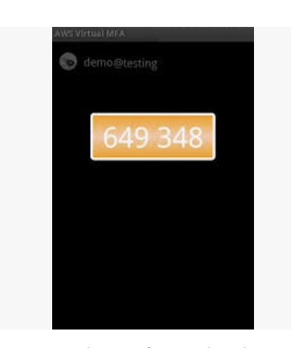
Security Device
U2F security key (Yubico Security Key) - Universal 2nd Factor (U2F) Security Key is a device that you can plug into a USB port on your computer. U2F is an open authentication standard hosted by the FIDO Alliance. When you enable a U2F security key, you sign in by entering your credentials and then tapping the device instead of manually entering a code.
Virtual MFA device - This is a software app that runs on a phone or other device and emulates a physical device. The device generates a six-digit numeric code based upon a time-synchronized one-time password algorithm. The user must type a valid code from the device on a second webpage during sign-in. Each virtual MFA device assigned to a user must be unique.
Hardware MFA device - This is a hardware device that generates a six-digit numeric code based upon a time-synchronized one-time password algorithm. The user must type a valid code from the device on a second webpage during sign-in. Each MFA device assigned to a user must be unique. A user cannot type a code from another user's device to be authenticated.
SMS text message-based MFA - This is a type of MFA in which the IAM user settings include the phone number of the user's SMS-compatible mobile device. When the user signs in, AWS sends a six-digit numeric code by SMS text message to the user's mobile device. The user is required to type that code on a second webpage during sign-in.
U2F security key
Hardware MFA device
Virual MFA device

Slide 2
S3
Use S3 Transfer Acceleration to improve the performance of your website - Amazon S3 Transfer Acceleration enables fast, easy, and secure transfers of files over long distances between your client and an S3 bucket.
Transfer Acceleration takes advantage of Amazon CloudFront’s globally distributed edge locations. As the data arrives at an edge location, data is routed to Amazon S3 over an optimized network path. Transfer Acceleration cannot be used to improve the performance of a static website.
Replication enables automatic, asynchronous copying of objects across Amazon S3 buckets. Buckets that are configured for object replication can be owned by the same AWS account or by different accounts. You can copy objects between different AWS Regions or within the same Region.
Although Amazon S3 stores your data across multiple geographically distant Availability Zones by default, compliance requirements might dictate that you store data at even greater distances. Cross-Region Replication (CRR) allows you to replicate data between distant AWS Regions to satisfy these requirements.
Amazon S3 Transfer Acceleration (S3TA) enables fast, easy, and secure transfers of files over long distances between your client and your Amazon S3 bucket. S3 Transfer Acceleration leverages Amazon CloudFront’s globally distributed AWS Edge Locations. As data arrives at an AWS Edge Location, data is routed to your Amazon S3 bucket over an optimized network path. S3 Transfer Acceleration is designed to optimize transfer speeds from across the world into S3 buckets. If you are uploading to a centralized bucket from geographically dispersed locations, or if you regularly transfer GBs or TBs of data across continents, you may save hours or days of data transfer time with S3 Transfer Acceleration.
S3 Transfer Acceleration:
Transfer acceleration makes use of the CloudFront network by sending or receiving data at CDN points of presence (called edge locations) rather than slower uploads or downloads at the origin.
This is accomplished by uploading to a distinct URL for the edge location instead of the bucket itself. This is then transferred over the AWS network backbone at a much faster speed.
AWS Global Accelerator - AWS Global Accelerator is a service that improves the availability and performance of your applications with local or global users. It provides static IP addresses that act as a fixed entry point to your application endpoints in a single or multiple AWS Regions, such as your Application Load Balancers, Network Load Balancers or Amazon EC2 instances. Similar to CloudFront it uses AWS Global network and edge locations for enhanced performance. It's an overall performance enhancer than an upload speed accelerator. You cannot use Global Accelerator to optimize media uploads into S3.

Slide 3
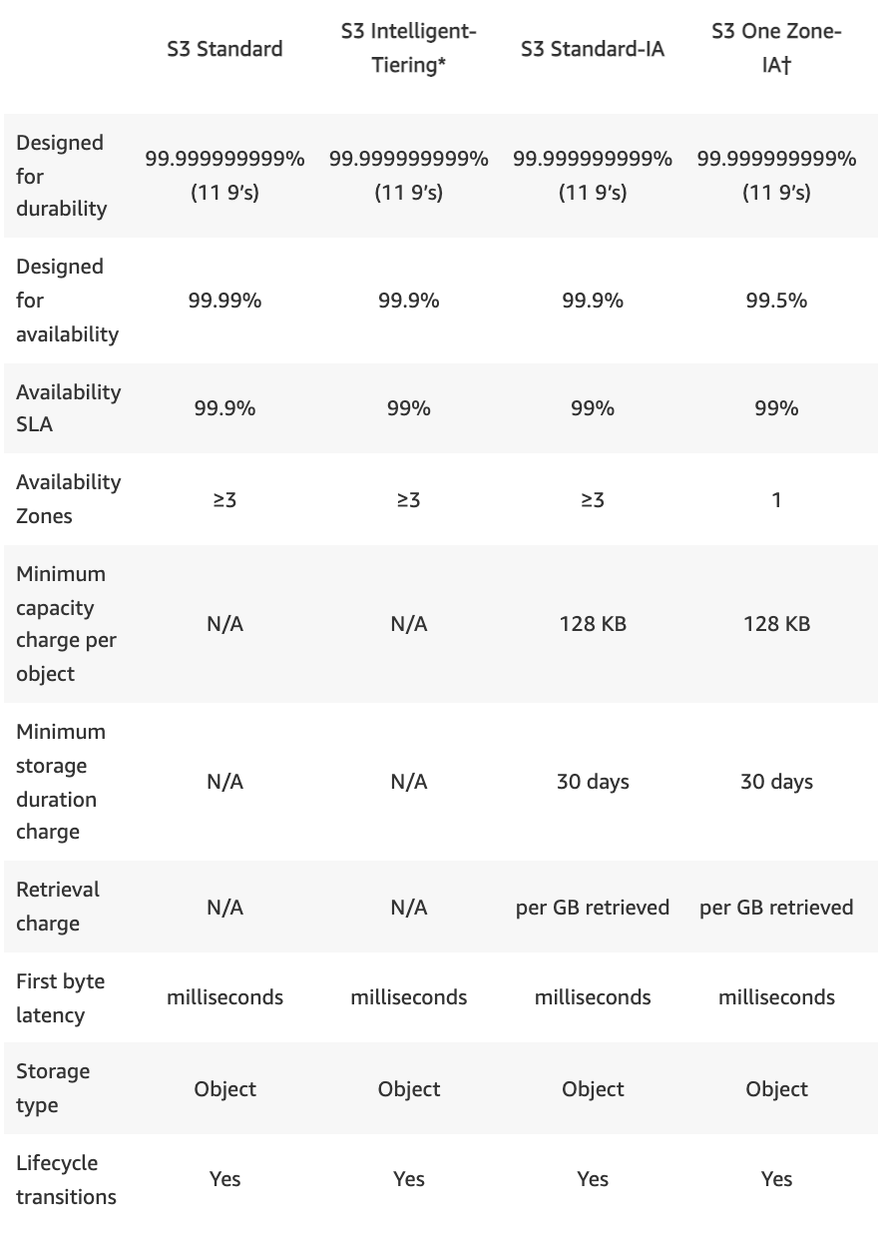
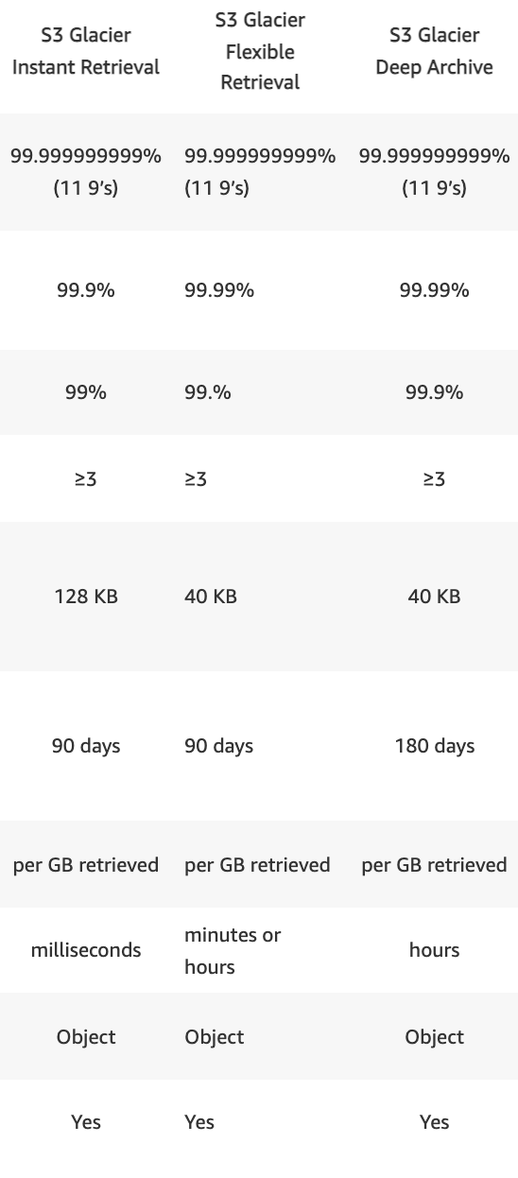
S3

Slide 4
S3
S3 Event Notications:
The Amazon S3 notification feature enables you to receive and send notifications when certain events happen in your bucket. To enable notifications, you must first configure the events you want Amazon S3 to publish (new object added, old object deleted, etc.) and the destinations where you want Amazon S3 to send the event notifications. Amazon S3 supports the following destinations where it can publish events:
Amazon Simple Notification Service (Amazon SNS) - A web service that coordinates and manages the delivery or sending of messages to subscribing endpoints or clients.
Amazon Simple Queue Service (Amazon SQS) - SQS offers reliable and scalable hosted queues for storing messages as they travel between computers.
AWS Lambda - AWS Lambda is a compute service where you can upload your code and the service can run the code on your behalf using the AWS infrastructure. You package up and upload your custom code to AWS Lambda when you create a Lambda function. The S3 event triggering the Lambda function also can serve as the code's input.
S3 and ElasticSearch:
If you are using S3 to store log files, ElasticSearch provides full search capabilities for logs and can be used to search through data stored in an S3 bucket.
You can integrate your ElasticSearch domain with S3 and Lambda. In this setup, any new logs received by S3 will trigger an event notification to Lambda, which in turn will then run your application code on the new log data. After your code finishes processing, the data will be streamed into your ElasticSearch domain and be available for observation.
S3 Encryption:
S3 data can be encrypted both in transit and at rest.
Encryption In Transit: When the traffic passing between one endpoint to another is indecipherable. Anyone eavesdropping between server A and server B won’t be able to make sense of the information passing by. Encryption in transit for S3 is always achieved by SSL/TLS.
Encryption At Rest: When the immobile data sitting inside S3 is encrypted. If someone breaks into a server, they still won’t be able to access encrypted info within that server. Encryption at rest can be done either on the server-side or the client-side. The server-side is when S3 encrypts your data as it is being written to disk and decrypts it when you access it. The client-side is when you personally encrypt the object on your own and then upload it into S3 afterwards.
Maximizing S3 Read/Write Performance:
If the request rate for reading and writing objects to S3 is extremely high, you can use sequential date-based naming for your prefixes to improve performance. Earlier versions of the AWS Docs also suggested to use hash keys or random strings to prefix the object’s name. In such cases, the partitions used to store the objects will be better distributed and therefore will allow better read/write performance on your objects.
If your S3 data is receiving a high number of GET requests from users, you should consider using Amazon CloudFront for performance optimization. By integrating CloudFront with S3, you can distribute content via CloudFront’s cache to your users for lower latency and a higher data transfer rate. This also has the added bonus of sending fewer direct requests to S3 which will reduce costs. For example, suppose that you have a few objects that are very popular. CloudFront fetches those objects from S3 and caches them. CloudFront can then serve future requests for the objects from its cache, reducing the total number of GET requests it sends to Amazon S3.
S3 Cross Region Replication:
Cross region replication only work if versioning is enabled.
When cross region replication is enabled, no pre-existing data is transferred. Only new uploads into the original bucket are replicated. All subsequent updates are replicated.
When you replicate the contents of one bucket to another, you can actually change the ownership of the content if you want. You can also change the storage tier of the new bucket with the replicated content.
When files are deleted in the original bucket (via a delete marker as versioning prevents true deletions), those deletes are not replicated.

Slide 5
S3
Amazon S3
You can manage your objects on S3 so that they are stored cost-effectively throughout their lifecycle by configuring their Amazon S3 Lifecycle. An S3 Lifecycle configuration is a set of rules that define actions that Amazon S3 applies to a group of objects.
There are two types of actions:
Transition actions — Define when objects transition to another storage class. For example, you might choose to transition objects to the S3 Standard-IA storage class 30 days after you created them, or archive objects to the S3 Glacier storage class one year after creating them.
Expiration actions — Define when objects expire. Amazon S3 deletes expired objects on your behalf.
https://docs.aws.amazon.com/AmazonS3/latest/userguide/object-lifecycle-mgmt.html

Slide 6
Amazon RDS
Amazon Relational Database Service (Amazon RDS) makes it easy to set up, operate, and scale a relational database in the cloud. It provides cost-efficient and resizable capacity while managing time-consuming database administration tasks, freeing you up to focus on your applications and business. Amazon RDS provides six familiar database engines to choose from, including Amazon Aurora, PostgreSQL, MySQL, MariaDB, Oracle, and Microsoft SQL Server.
Amazon Aurora
Amazon Aurora is a relational database engine. It is designed to deliver the speed and reliability of high-end commercial databases in a simple and cost-effective manner. Aurora is designed to be compatible with MySQL 5.6 and delivers five times the throughput of standard MySQL running on the same hardware. DBAs are able to save time on planning backup storage disks, as data is continuously backed up to AWS S3 in real time, with no performance impact to the end user. This eliminates the need for backup windows and automated backup scripts. Aurora replicates data to six storage nodes in Multi AZs to withstand the loss of an entire AZ or two storage nodes without any availability impact to the client’s applications.
Performance is one of the key KPIs for businesses, and DBAs have to stay on top of it by ensuring optimal throughput with the given hardware. The storage disk has always been a bottleneck due to its comparatively slow speed for databases. Amazon RDS uses SSDs in all its database services to achieve better IO throughput.
Amazon Aurora provides five times the throughput of standard MySQL or twice the throughput of standard PostgreSQL running on the same hardware. Amazon achieves this by using software and hardware techniques to ensure the database engine is able to fully leverage available compute, memory, and networking.

Slide 7
Benefits of cloud computing
Agility - The cloud gives you easy access to a broad range of technologies so that you can innovate faster and build nearly anything that you can imagine. You can quickly spin up resources as you need them–from infrastructure services, such as compute, storage, and databases, to Internet of Things, machine learning, data lakes and analytics, and much more.
You can deploy technology services in a matter of minutes, and get from idea to implementation several orders of magnitude faster than before. This gives you the freedom to experiment, test new ideas to differentiate customer experiences, and transform your business.
Elasticity - With cloud computing, you don’t have to over-provision resources up front to handle peak levels of business activity in the future. Instead, you provision the amount of resources that you actually need. You can scale these resources up or down to instantly grow and shrink capacity as your business needs change.
Deploy globally in minutes - With the cloud, you can expand to new geographic regions and deploy globally in minutes. For example, AWS has infrastructure all over the world, so you can deploy your application in multiple physical locations with just a few clicks. Putting applications in closer proximity to end users reduces latency and improves their experience.
Cost savings - The cloud allows you to trade capital expenses (such as data centers and physical servers) for variable expenses, and only pay for IT as you consume it. Plus, the variable expenses are much lower than what you would pay to do it yourself because of the economies of scale.
Trade fixed expense for variable expense – Instead of having to invest heavily in data centers and servers before you know how you’re going to use them, you can pay only when you consume computing resources, and pay only for how much you consume.
Benefit from massive economies of scale – By using cloud computing, you can achieve a lower variable cost than you can get on your own. Because usage from hundreds of thousands of customers is aggregated in the cloud, providers such as AWS can achieve higher economies of scale, which translates into lower pay as-you-go prices.
Stop guessing capacity – Eliminate guessing on your infrastructure capacity needs. When you make a capacity decision prior to deploying an application, you often end up either sitting on expensive idle resources or dealing with limited capacity. With cloud computing, these problems go away. You can access as much or as little capacity as you need, and scale up and down as required with only a few minutes’ notice.
Increase speed and agility – In a cloud computing environment, new IT resources are only a click away, which means that you reduce the time to make those resources available to your developers from weeks to just minutes. This results in a dramatic increase in agility for the organization, since the cost and time it takes to experiment and develop is significantly lower.
Stop spending money running and maintaining data centers – Focus on projects that differentiate your business, not the infrastructure. Cloud computing lets you focus on your own customers, rather than on the heavy lifting of racking, stacking, and powering servers.
Go global in minutes – Easily deploy your application in multiple regions around the world with just a few clicks. This means you can provide lower latency and a better experience for your customers at minimal cost.

Slide 8
DR
Plan for Disaster Recovery (DR)
Define recovery objectives for downtime and data loss: The workload has a recovery time objective (RTO) and recovery point objective (RPO).
Recovery Time Objective (RTO) is defined by the organization. RTO is the maximum acceptable delay between the interruption of service and restoration of service. This determines what is considered an acceptable time window when service is unavailable.
Recovery Point Objective (RPO) is defined by the organization. RPO is the maximum acceptable amount of time since the last data recovery point. This determines what is considered an acceptable loss of data between the last recovery point and the interruption of service.
Use defined recovery strategies to meet the recovery objectives:
A disaster recovery (DR) strategy has been defined to meet objectives. Choose a strategy such as:
backup and restore, active/passive (pilot light or warm standby), or active/active.
When architecting a multi-region disaster recovery strategy for your workload, you should choose one of the following multi-region strategies. They are listed in increasing order of complexity, and decreasing order of RTO and RPO. DR Region refers to an AWS Region other than the one primary used for your workload (or any AWS Region if your workload is on premises).
Backup and restore (RPO in hours, RTO in 24 hours or less: Back up your data and applications using point-in-time backups into the DR Region. Restore this data when necessary to recover from a disaster.
Pilot light (RPO in minutes, RTO in hours: Replicate your data from one region to another and provision a copy of your core workload infrastructure. Resources required to support data replication and backup such as databases and object storage are always on. Other elements such as application servers are loaded with application code and configurations, but are switched off and are only used during testing or when Disaster Recovery failover is invoked.
Warm standby (RPO in seconds, RTO in minutes: Maintain a scaled-down but fully functional version of your workload always running in the DR Region. Business-critical systems are fully duplicated and are always on, but with a scaled down fleet. When the time comes for recovery, the system is scaled up quickly to handle the production load. The more scaled-up the Warm Standby is, the lower RTO and control plane reliance will be. When scaled up to full scale this is known as a Hot Standby.
Multi-region (multi-site) active-active (RPO near zero, RTO potentially zero: Your workload is deployed to, and actively serving traffic from, multiple AWS Regions. This strategy requires you to synchronize data across Regions. Possible conflicts caused by writes to the same record in two different regional replicas must be avoided or handled. Data replication is useful for data synchronization and will protect you against some types of disaster, but it will not protect you against data corruption or destruction unless your solution also includes options for point-in-time recovery. Use services like Amazon Route 53 or AWS Global Accelerator to route your user traffic to where your workload is healthy.

Slide 9
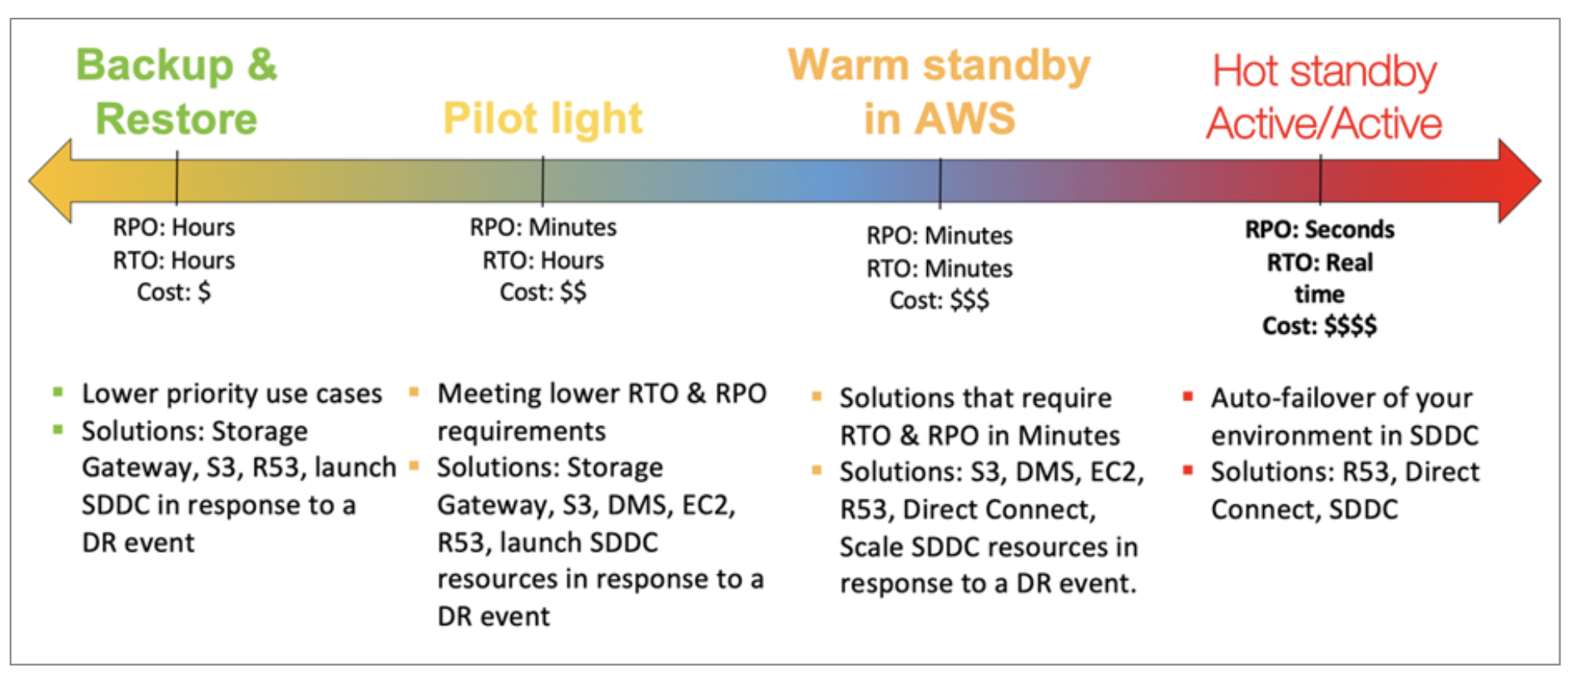
DR

Slide 10
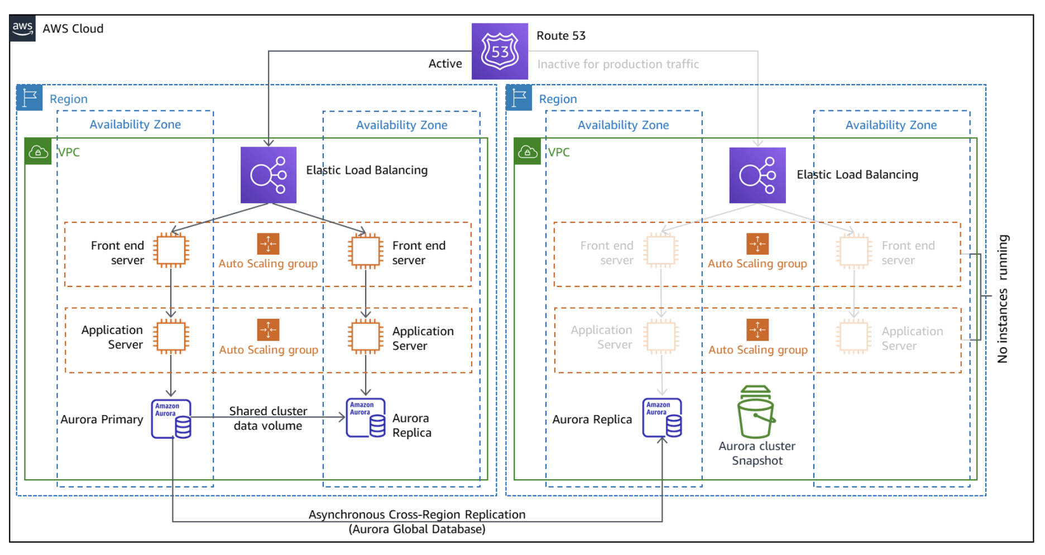
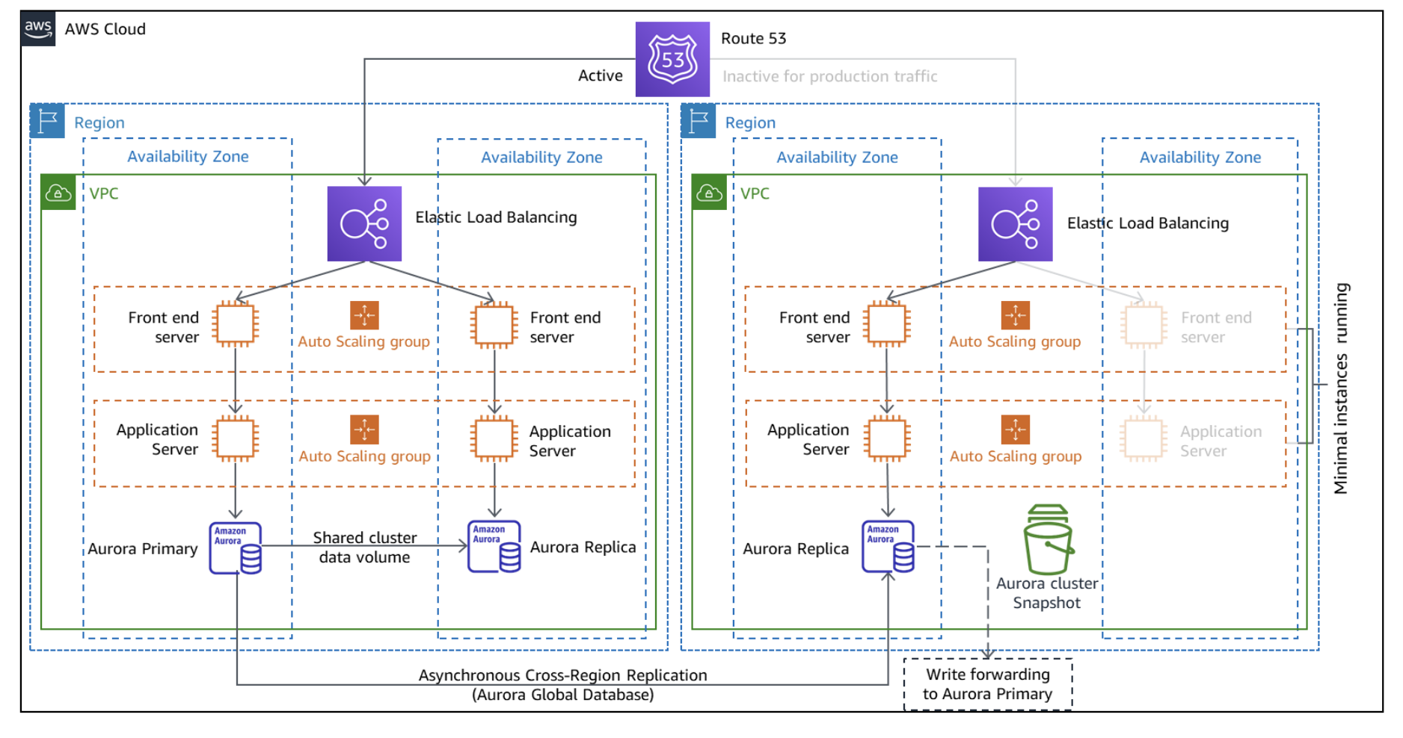
DR
Pilot light DR strategy
Warm standby DR strategy
Differences between these two DR strategies
The primary difference between the two strategies is infrastructure deployment and readiness. The warm standby strategy deploys a functional stack, but at reduced capacity. The DR endpoint can handle requests, but cannot handle production levels of traffic. This is shown as one Amazon Elastic Compute Cloud (Amazon EC2) instance per tier in Figure 3. It may be more, but is always less than the full production deployment for cost savings. If the passive stack is deployed to the recovery Region at full capacity however, then this strategy is known as “hot standby.” Because warm standby deploys a functional stack to the recovery Region, this makes it easier to test Region readiness using synthetic transactions.
A pilot light in a home furnace does not provide heat to the home. It provides a quick way to light the furnace burners that then provide heat. Similarly, the DR Region in a pilot light strategy (unlike warm standby) cannot serve requests until additional steps are taken. Figure 2 shows an EC2 Auto Scaling group that is configured, but it has no deployed EC2 instances.
RTO for these strategies is different. Warm standby can handle traffic at reduced levels immediately. Then it requires you to scale out this existing deployment, which gives it a lower RTO time than pilot light. This is because pilot light requires you to first deploy infrastructure and then scale out resources before the workload can handle requests.
https://aws.amazon.com/blogs/architecture/disaster-recovery-dr-architecture-on-aws-part-iii-pilot-light-and-warm-standby/

Slide 11
The difference between AWS CloudWatch and CloudTrail
AWS CloudWatch monitors your AWS resources and applications, whereas CloudTrail monitors the activity in your AWS environment. For instance, with CloudWatch, you can scale your applications, whereas, with CloudTrail, you can see who did what to your applications.
CloudWatch monitors performance, whereas CloudTrail monitors actions in your AWS environment.
Lambda Version
You can use versions to manage the deployment of your functions. For example, you can publish a new version of a function for beta testing without affecting users of the stable production version. Lambda creates a new version of your function each time that you publish the function.
You can create a function version using the Lambda console.
To create a new function version
Open the Functions page of the Lambda console.
Choose a function and then choose Versions.
On the versions configuration page, choose Publish new version.
(Optional) Enter a version description.
Choose Publish
Lambda Shared Responsibility.
When customers use AWS Lambda, AWS manages the underlying infrastructure and foundation services, the operating system, and the application platform. Customers themselves are responsible for the security of their code, the storage and accessibility of sensitive data, and identity and access management (IAM) to the Lambda service and within their function.

Slide 12
Analytics
https://www.parkmycloud.com/aws-services-list/
Amazon Athena – Released November 30, 2016
An interactive query service that makes it easy to analyze data in Amazon S3 using standard SQL.
Athena is serverless so there is no infrastructure to manage
Amazon CloudSearch – Released April 11, 2012
Makes it simple and cost-effective to set up, manage, and scale a search solution for your website or application.
Amazon Kinesis – Released December 16, 2013
Makes it easy to collect, process, and analyze real-time, streaming data so you can get timely insights and react quickly to new information
Offers key capabilities to cost-effectively process streaming data at any scale, along with the flexibility to choose the tools that best suit the requirements of your application
You can ingest real-time data such as video, audio, application logs, website clickstreams, and IoT telemetry data for machine learning, analytics, and other applications.
Amazon Elasticsearch Service – Released October 1, 2015
Makes it easy for you to deploy, secure, and operate Elasticsearch at scale with zero down time
Offers open-source Elasticsearch APIs, managed Kibana, and integrations with Logstash and other AWS Services, enabling you to securely ingest data from any source and search, analyze, and visualize it in real time.
Elasticsearch is a highly scalable open-source full-text search and analytics engine. It allows you to store, search, and analyze big volumes of data quickly and in near real time.
Amazon EMR – Released April 2009
Provides a managed Hadoop framework that makes it easy, fast, and cost-effective to process vast amounts of data across dynamically scalable Amazon EC2 instances.
Securely and reliably handles a broad set of big data use cases, including log analysis, web indexing, data transformations (ETL), machine learning, financial analysis, scientific simulation, and bioinformatics.

Slide 13
Analytics
Amazon Redshift – Released February 14, 2013
A fast, scalable data warehouse that makes it simple and cost-effective to analyze all your data across your data warehouse and data lake.
Delivers ten times faster performance than other data warehouses by using machine learning, massively parallel query execution, and columnar storage on high-performance disk.
AWS Data Pipeline – Released December 2012
A web service that helps you reliably process and move data between different AWS compute and storage services, as well as on-premises data sources, at specified intervals
You can regularly access your data where its stored, transform and process it at scale, and efficiently transfer the results to AWS services
Helps you easily create complex data processing workloads that are fault tolerant, repeatable, and highly available.
Amazon Quicksight – Released November 15, 2016
Makes it easy to deliver insights to everyone in your organization
Lets you easily create and publish interactive dashboards that include ML Insights.
Dashboards can then be accessed from any device, and embedded into your applications, portals, and websites.
Amazon Managed Streaming for Kafka – Announced November 29, 2018
Makes it easy for you to build and run applications that use Apache Kafka to process streaming data
An open-source platform for building real-time streaming data pipelines and applications
You can use Apache Kafka APIs to populate data lakes, stream changes to and from databases, and power machine learning and analytics applications.
AWS Glue – Released August 14, 2017
Extract, transform, and load (ETL) service that makes it easy for customers to prepare and load their data for analytics
You can create and run an ETL job with a few clicks in the AWS Management Console.
You simply point AWS Glue to your data stored on AWS, and AWS Glue discovers your data and stores the associated metadata (e.g. table definition and schema) in the AWS Glue Data Catalog
AWS Lake Formation – Released August 8, 2019
Makes it easy to set up a secure data lake in days.
Lake Formation collects and catalogs data from databases and object storage, moves the data into your new Amazon S3 data lake, cleans and classifies data using machine learning algorithms, and secures access to your sensitive data.
AWS Data Exchange – Released November 13, 2019
A service that makes it easy for AWS customers to find, subscribe to and use third-party data in the cloud.

Slide 14
Application Integration
AWS Step Functions – Released December 1, 2016
Lets you coordinate multiple AWS services into serverless workflows so you can build and update apps quickly
You can design and run workflows that stitch together services such as AWS Lambda and Amazon ECS into feature-rich applications.
Amazon Simple Queue Service (SQS) – Released November 5, 2012
Message queuing service that enables you to decouple and scale microservices, distributed systems, and serverless applications.
Eliminates the complexity and overhead associated with managing and operating message oriented middleware, and empowers developers to focus on differentiating work.
Using SQS, you can send, store, and receive messages between software components at any volume, without losing messages or requiring other services to be available
Amazon EventBridge – Released July 11, 2019
A serverless event bus that connects applications together using data from your own apps, SaaS apps, and AWS services.
An event is a signal that a system’s state has changed (e.g. a change in the status of a customer support ticket).
You can set up routing rules to determine where to send your data to build application architectures that react in real-time to all of your data sources.

Slide 15
Application Integration
Amazon MQ – Released November 28, 2017
Managed message broker service for Apache ActiveMQ that makes it easy to set up and operate message brokers in the cloud.
Reduces your operational load by managing the provisioning, setup, and maintenance of ActiveMQ, a popular open-source message broker
Amazon Simple Notification Service (SNS) – Released April 7, 2010
Durable, secure, fully managed pub/sub messaging service that enables you to decouple microservices, distributed systems, and serverless applications
Provides topics for high-throughput, push-based, many-to-many messaging.
Amazon AppFlow – Released April 2020
No code integration for SaaS applications and AWS services – you can securely transfer data between SaaS applications like Salesforce, Slack, and ServiceNow, and AWS services.
Can be used to set up data flows in minutes with no coding required.
Easily scales up so there’s no need to plan or provision resources giving you the ability to move large volumes of data without having to break it down into numerous batches.
Automatically encrypts data in motion reducing exposure to security threats.
You can run data flows at nearly any scale at the frequency you choose.
Amazon AppSync – Released April 13, 2018
Simplifies application development by letting you create a flexible API to securely access, manipulate, and combine data from one or more data sources
You can build scalable applications, including those requiring real-time updates, on a range of data sources such as NoSQL data stores, relational databases, HTTP APIs, and your custom data sources with AWS Lambda.

Slide 16
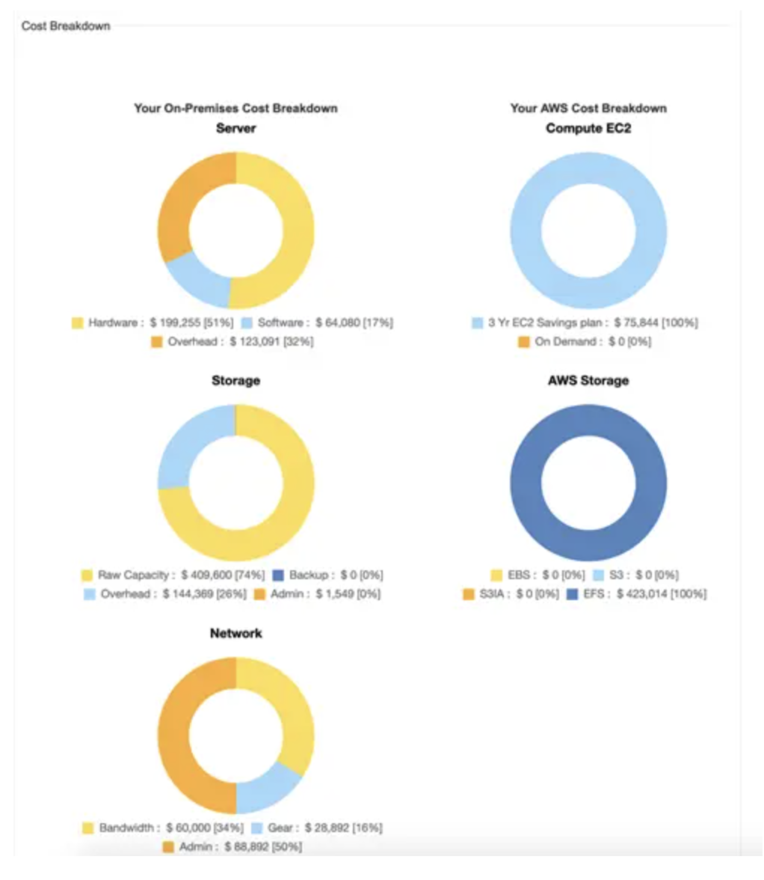
AWS Calculators
There are three calculators currently offered by AWS: the AWS Simple Monthly Calculator, the AWS Pricing Calculator, and the AWS TCO Comparison Calculator.
AWS Total Cost of Ownership (TCO) Comparison Calculator
The AWS Total Cost of Ownership (TCO) Calculator, unlike the previous two tools, has a specific purpose: It is used to compare the cost of your on-premises environment to the cost of an AWS environment. Not only does it allow you to calculate the various cost savings you’ll experience when moving to the cloud, it also provides detailed reports that can be used for presentation purposes.
https://n2ws.com/blog/aws-pricing-calculators

Slide 17
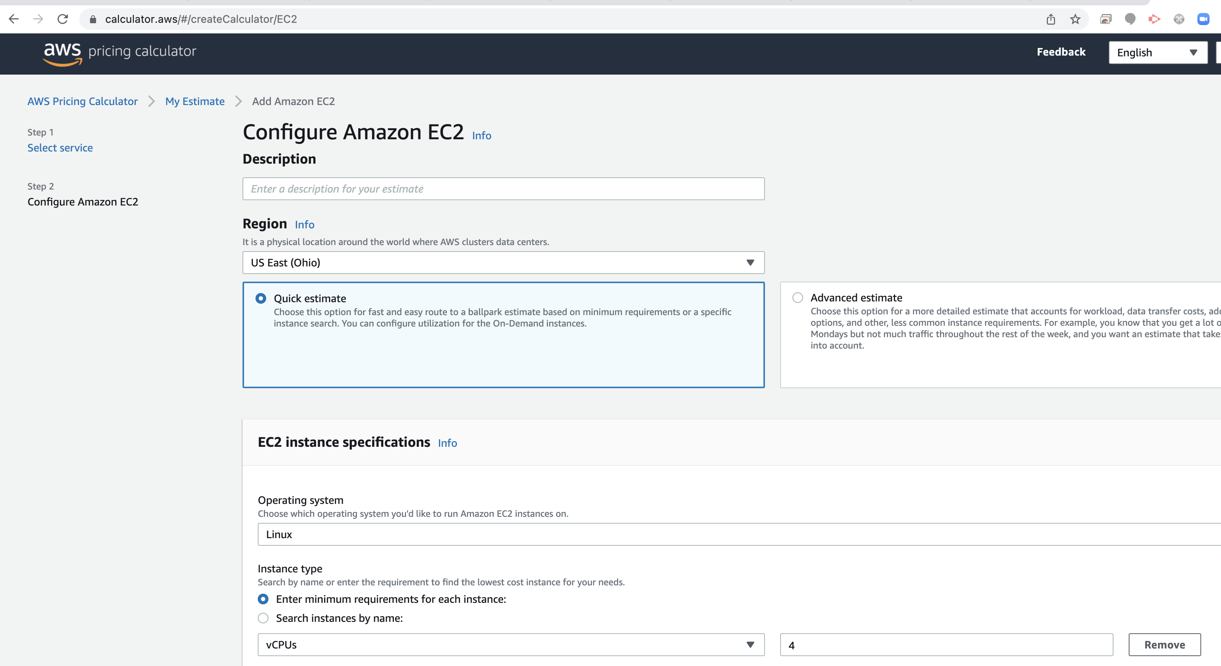
AWS Pricing Calculator
The AWS Pricing Calculator is a newer product meant to replace the Simple Monthly Calculator in the near future (though its deprecation has been postponed). It is still a work in progress, but it already provides support for over 50 services to help you project your monthly spending.
With the AWS Pricing Calculator, you create “estimates” to which you add the various services you want to check the costs of. You can later export these estimates as a CSV file.
To use the AWS Pricing Calculator, open its page, and click on “Create estimate.”

Slide 18
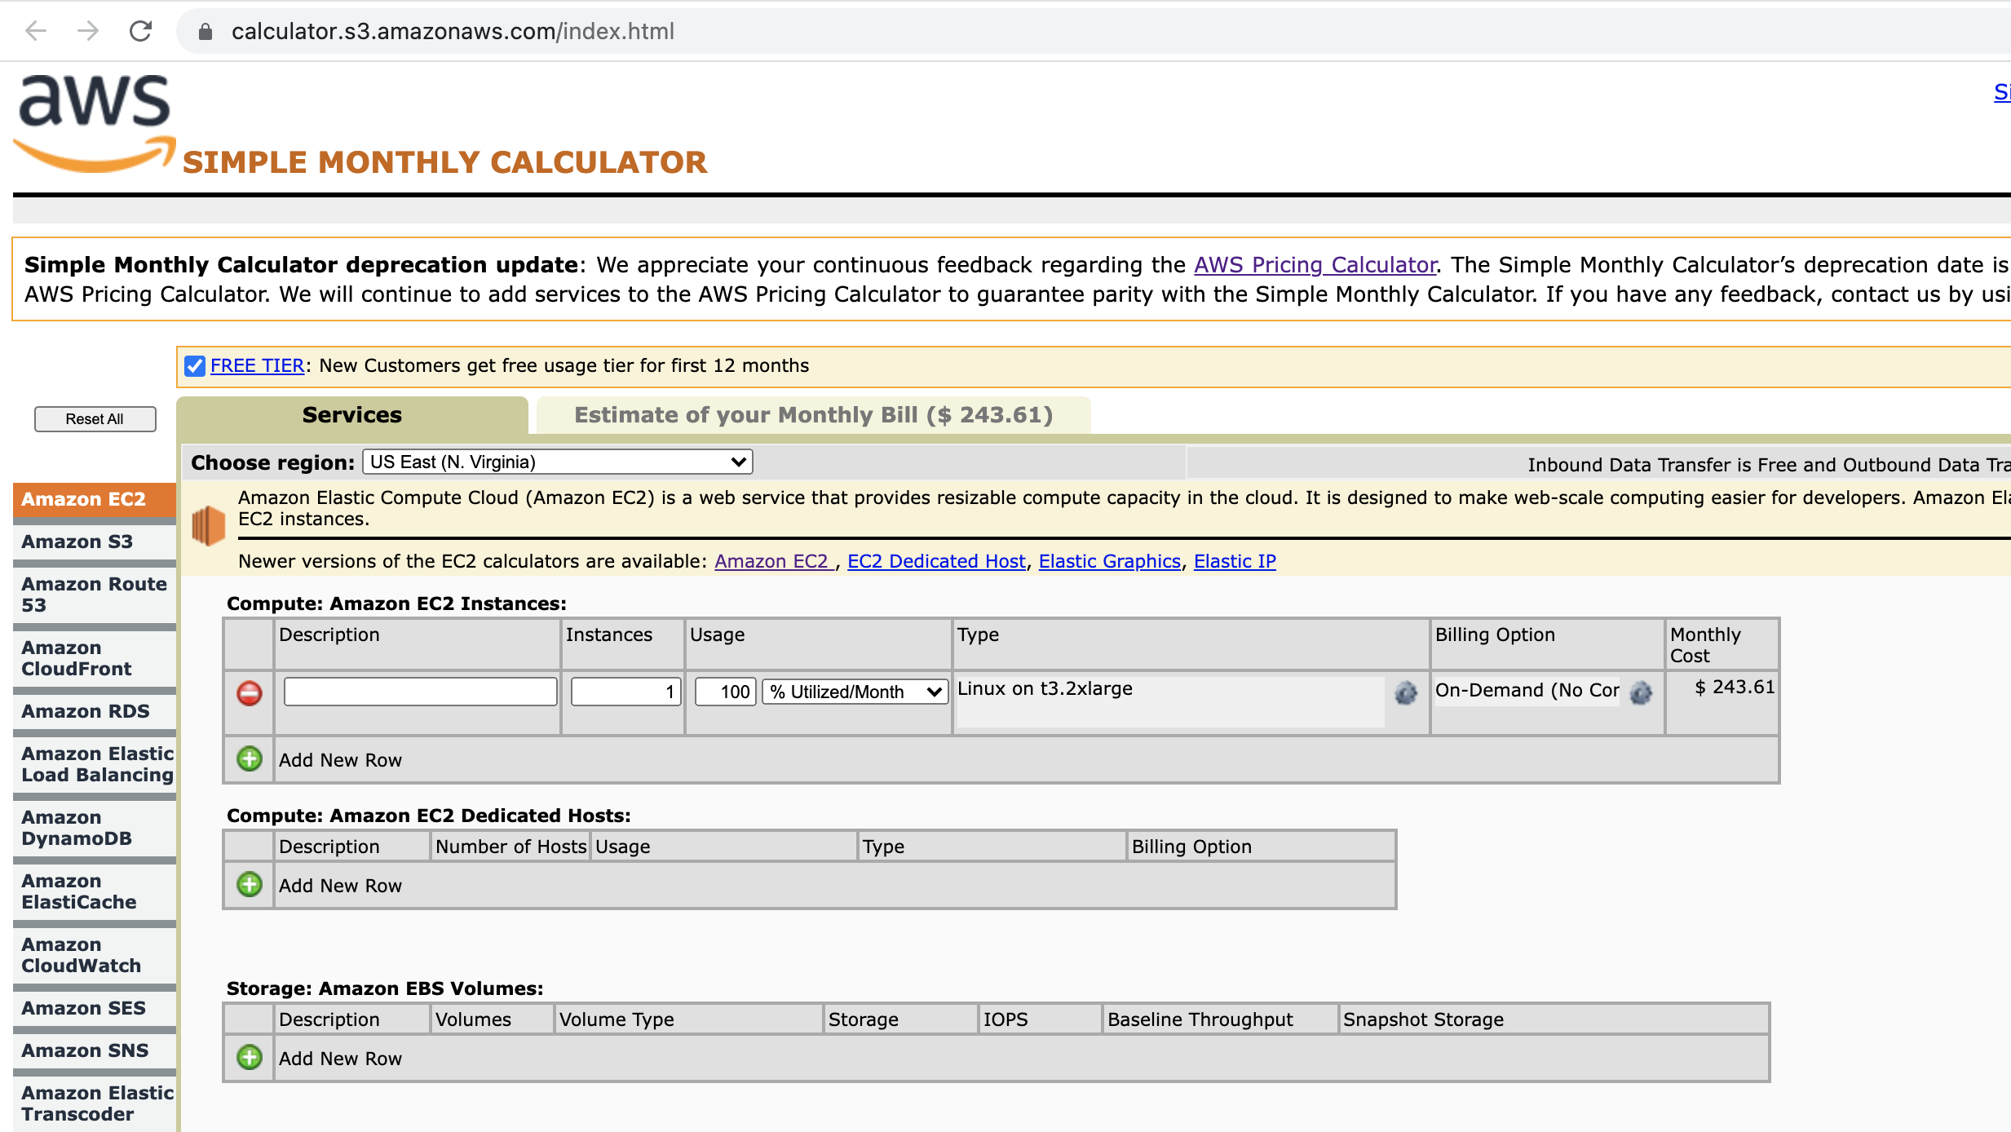
AWS Simple Monthly Calculator
The AWS Simple Monthly Calculator is, as its name states, a simple product that can handle most of your important calculations for you. It is very easy to use, and it works with numerous services, including EC2 backup, AWS S3, DynamoDB, and AWS Elastic Load Balancing Services (ELBs).

Slide 19
AWS Partner Network (APN) is a group of cloud software and service vendors that have earned endorsement from Amazon Web Services after meeting several criteria.
AWS divides partners into two groups: APN Consulting Partners and APN Technology Partners.
An APN Consulting Partner helps an AWS customer implement and manage an AWS cloud deployment. These types of partners include system integrators, managed services providers, and other consultancies and agencies.
An APN Technology Partner provides software tools and services that are hosted on or integrate with AWS. These types of partners include independent software vendors and providers of software as a service, platform as a service, developer and security tools.
AWS Professional Services organization
Adopting the AWS Cloud can provide you with sustainable business advantages. Supplementing your team with specialized skills and experience can help you achieve those results. The AWS Professional Services organization is a global team of experts that can help you realize your desired business outcomes when using the AWS Cloud. We work together with your team and your chosen member of the AWS Partner Network (APN) to execute your enterprise cloud computing initiatives.
Our team provides assistance through a collection of offerings which help you achieve specific outcomes related to enterprise cloud adoption. We also deliver focused guidance through our global specialty practices, which cover a variety of solutions, technologies, and industries.
Engaging Right Partners can accelerate your journey.
https://searchaws.techtarget.com/definition/AWS-Partner-Network-APN

Slide 20
AWS Elastic Beanstalk -
is an easy-to-use service for deploying and scaling web applications and services developed with Java, .NET, PHP, Node.js, Python etc.
You can simply upload your code in a programming language of your choice and Elastic Beanstalk automatically handles the deployment, from capacity provisioning, load balancing, auto-scaling to application health monitoring.
AWS CodeBuild -
is a fully managed continuous integration service that compiles source code, runs tests, and produces software packages that are ready to deploy.
With CodeBuild, you don’t need to provision, manage, and scale your own build servers.
CodeBuild scales continuously and processes multiple builds concurrently, so your builds are not left waiting in a queue.

Slide 21
IAM access advisor
Access advisor shows the service permissions granted to a user and when those services were last accessed. You can use this information to revise your policies. To summarize, you can identify unnecessary permissions so that you can revise your IAM policies accordingly.
IAM access advisor uses data analysis to help you set permission guardrails confidently by providing service last accessed information for your accounts, organizational units (OUs), and your organization managed by AWS Organizations. Permission guardrails help control which services your developers and applications can access. By analyzing last accessed information, you can determine the services not used by IAM users and roles. You can implement permissions guardrails using service control policies (SCPs) that restrict access to those services.
You can review service last accessed information for your AWS organization in the IAM console in your organization’s master account or programmatically using IAM access advisor APIs with the AWS Command Line Interface (AWS CLI) or a programmatic client.
IAM credentials report -
You can generate and download a credential report that lists all users in your account and the status of their various credentials, including passwords, access keys, and MFA devices. It is not used to review permissions granted to a user.
IAM policies - IAM policies define permissions for an action regardless of the method that you use to perform the operation.

Slide 22
Amazon ElastiCache
Amazon ElastiCache is a web service that makes it easy to deploy, operate, and scale an in-memory cache in the cloud. The service improves the performance of web applications by allowing you to retrieve information from fast, managed, in-memory caches, instead of relying entirely on slower disk-based databases.
If EC2 instances are intensively reading data from a database, ElastiCache can cache some values to take the load off the database.
ElastiCache is often used with RDS to take the load off RDS.
AWS Batch
AWS Batch enables developers, scientists, and engineers to easily and efficiently run hundreds of thousands of batch computing jobs on AWS.
You can use AWS Batch to plan, schedule, and execute your batch computing workloads across the full range of AWS compute services. AWS Batch dynamically provisions the optimal quantity and type of compute resources (e.g., CPU or memory optimized instances) based on the volume and specific resource requirements of the batch jobs submitted. AWS Batch provisions compute resources and optimizes the job distribution based on the volume and resource requirements of the submitted batch jobs.
Please review the common use-cases for AWS Batch:
Amazon Lightsail
is designed to be the easiest way to launch and manage a virtual private server with AWS. Lightsail plans include everything you need to jumpstart your project – a virtual machine, SSD- based storage, data transfer, DNS management, and a static IP address – for a low, predictable price. It is not used to run batch jobs.
AWS Fargate
is a compute engine for Amazon ECS that allows you to run containers without having to manage servers or clusters. You can run batch jobs on Fargate, but it is more expensive than AWS Batch.

Slide 23
https://www.examtopics.com/
https://awslagi.com/aws-certified-cloud-practitioner/
https://www.exam4training.com/vendor/amazon/
https://pegacert.com/vendor/aws/scs-c01

